Slide 1


Learning Energy Efficient Jumping Strategies for Flexible-Legged Systems
MECC 2021
Andrew Albright, Joshua Vaughan
Dept. of Mechanical Engineering
Univ. of Louisiana at Lafayette
andrew.albright1@louisiana.edu, joshua.vaughan@louisiana.edu
Notes:
Hello everyone and welcome to our presentation on the Utilization of Reinforcement Learning for Defining Energy Efficient Jumping Strategies for Flexible Legged Systems.
My name is Andrew Albright, and I will be presenting the findings of this work which was completed by myself and Dr. Joshua Vaughan at the University of Louisiana at Lafayette.
Additionally, we would like to thank the Louisiana Crawfish Promotion and Research Board for their support of this work, along with the MECC conference for hosting this work.

Slide 2
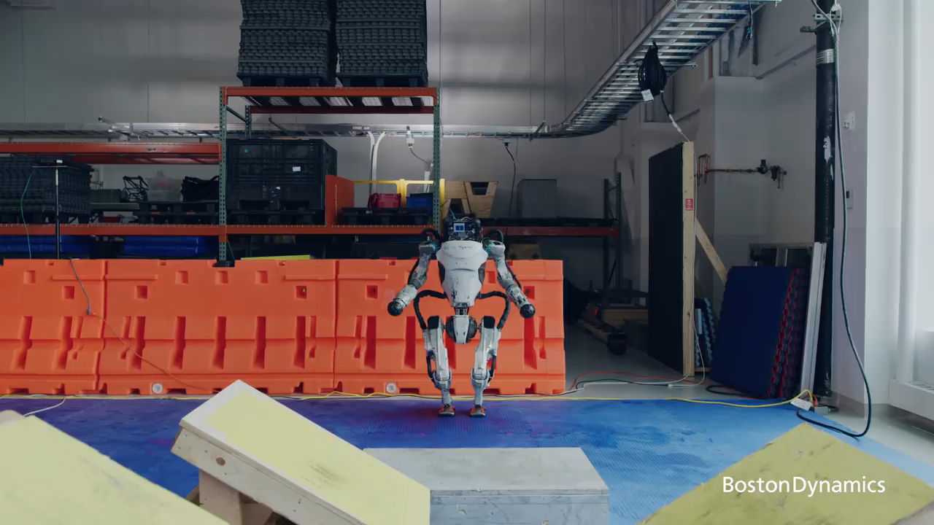
Pros of Legged Robots
https://www.bostondynamics.com/atlas
Notes:
To start things off, let’s take a look at a video highlighting the performance of a legged robot which I am sure many of you are familiar with.
This is of course the Boston Dynamics Atlas robot, and here it is shown completing a number of tasks related to traversing extreme terrain.
This video highlights the potential of legged robots exceling in these type of environments especially compared wheeled or tracked vehicle which might not be able to traverse over these obstacles.
Atlas can be seen performing a number of different actions such as running, jumping and balancing.
Furthermore, a legged robot equipped with additional appendages such as this one, is capable of actions such as mantling as was just seen.
It is for these reasons that we are interested in studying legged locomotive robots to begin with.
That and the fact that robots doing backflips, and performing dance moves is super awesome!
As cool as these robots are however, they can be a challenge to define control strategies for.

Slide 3
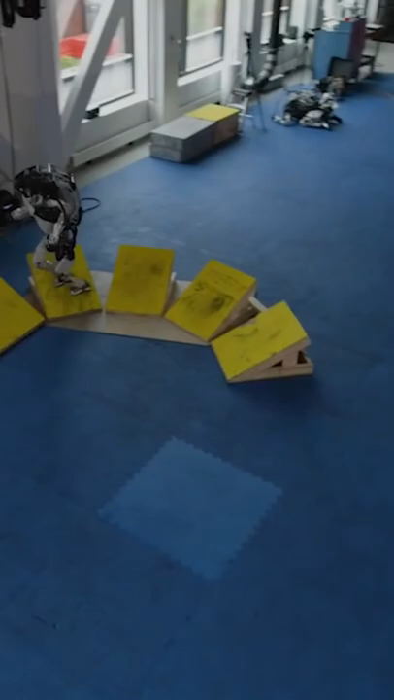
Cons of Legged Robots
Watch the Atlas Robot take a spill running parkour #shorts - YouTube
Notes:
Highlighted in this quick reel, are some of the many attempts to get a perfect run of the previous video.
Legged robots are innately challenging to design controllers for due to things like maintaining balance and ensuring proper foot placement.
Additionally, a challenge that can be overlooked but effects the reality of legged robots roaming the streets one day, is the challenge of maintaining a low power budget.
Legged robotic systems tend to be power inefficient in terms of ground covered compared to their wheeled counterparts.
As such, it is of interest to discover ways to reduce the power needs of such systems.

Slide 4
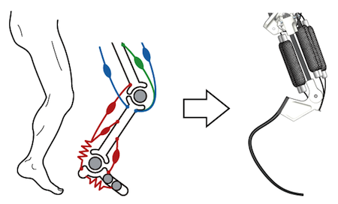
Legged & Flexible Robots
Pros
Increases in efficiency
Better stability through adaptability
Higher performance
Running speed
Jumping height
Cons
Difficult to define models for due to non-linearities
Challenging to create controllers for
Notes:
One approach to solve this power problem is the utilization of flexible components within a legged system.
This has been shown to improve performance metrics such as efficiency, increased walking stability, higher movement velocity.
However, these gains do not come at no cost.
Flexible systems can be difficult to define models for because the non-linearities that exist due to the flexibility.
Because they are difficult to define models for, they are also difficult to define control strategies for.
TODO:
Get citation

Slide 5
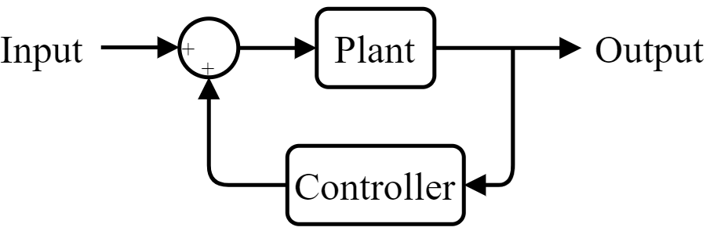
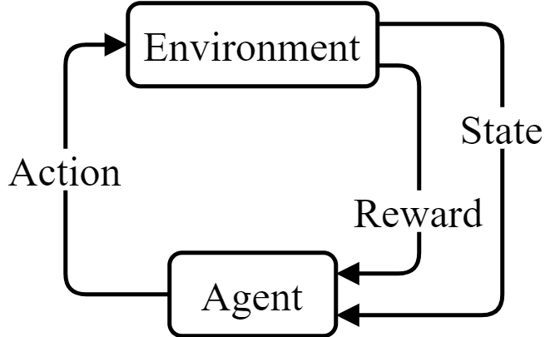
Control Methods
Traditional Controls Method
Reinforcement Learning Method
Notes:
In this work, instead of utilizing what might be considered a traditional controls method to find a control strategy for a flexible legged system, Reinforcement learning was used.
The lower block diagram highlights the general flow of a Reinforcement Learning controller both during and after training.
That is, there is an Environment (the legged robotic system) and an Agent (the control strategy) where,
(click)
Similar to a traditional controller, the reinforcement learning controller receives the current state
(click)
and sends the updated desired state.
(click)
Additionally, the controller receives a reward, which during training an algorithm can use to re-shape or learn the controller.
For the remainder of this presentation, the term RL will be used to reference Reinforcement Learning and the term Agent will be used to reference the control strategy.

Slide 6
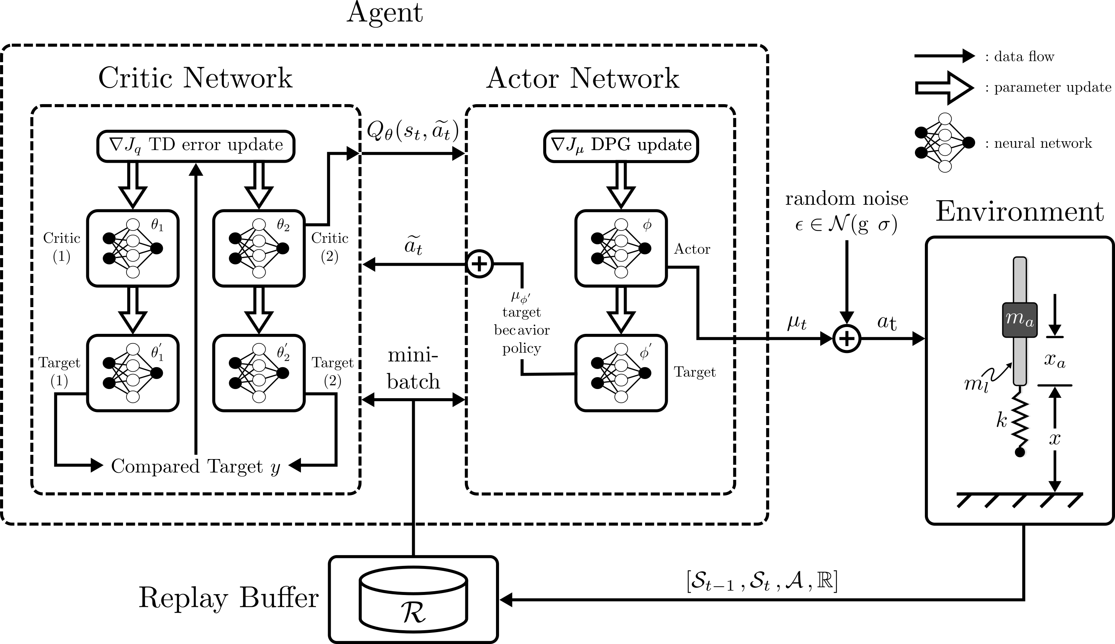
Algorithm Used – TD3
Structure of TD3 (Twin Delayed Deep Deterministic Policy Gradient) with... | Download Scientific Diagram (researchgate.net)
Notes:
The algorithm used for this work was the Twin Delayed Deep Deterministic Policy Gradient algorithm, or TD3.
This algorithm is based in the popular Deep Deterministic Policy Gradient algorithm, or DDPG.
Presented here is a general block diagram describing the algorithm. We won’t go into great detail, but we’ll cover a general sense of the learning process.
(click)
Please take note first, the key in the top right of the diagram.
(click)
TD3 is an actor critic learning algorithm wherein there exists two separate neural networks. Both can be seen highlighted on screen.
The actor is the agent and therefore the controller of the system such that a neural network is the approximator of the optimal controller.
(click)
The actor is further broken into two separate networks, a main network and a target network. The target network is used to supply the critic network with an action and to keep the main actor network from learning too quickly where diverging solutions might be found.
The critic is a training network and is broken into 4 sub-neural networks.
(click)
Two of them are twin main networks and two of them are twin target networks. The target networks, similar to the actor, trail the main networks and are used to train them by way of reducing temporal difference error between them and the main network.
Twin networks are used in general as this has been shown to reduce stalling during training.
(click)
Additionally during training, the actions taken by the agent are stored in a replay buffer which is used by the target actor to generate actions for the target critics. Because of this, TD3 is considered an off-policy learning algorithm where past experiences are used for training.

Slide 7
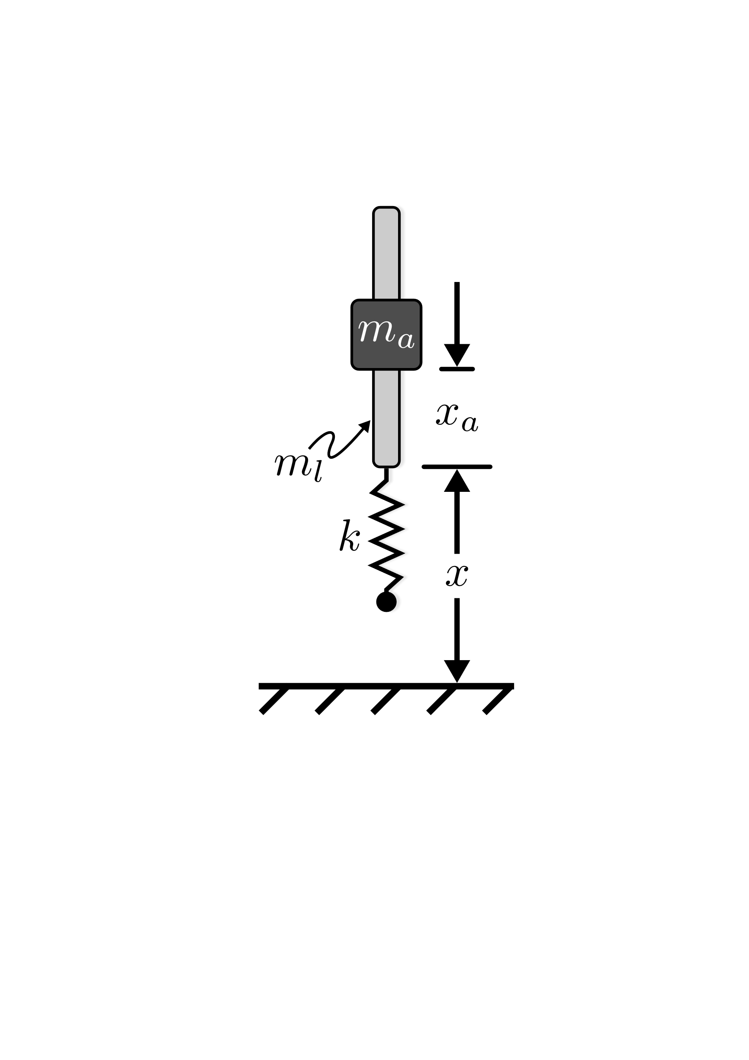
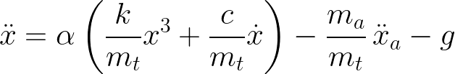
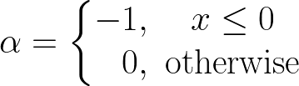
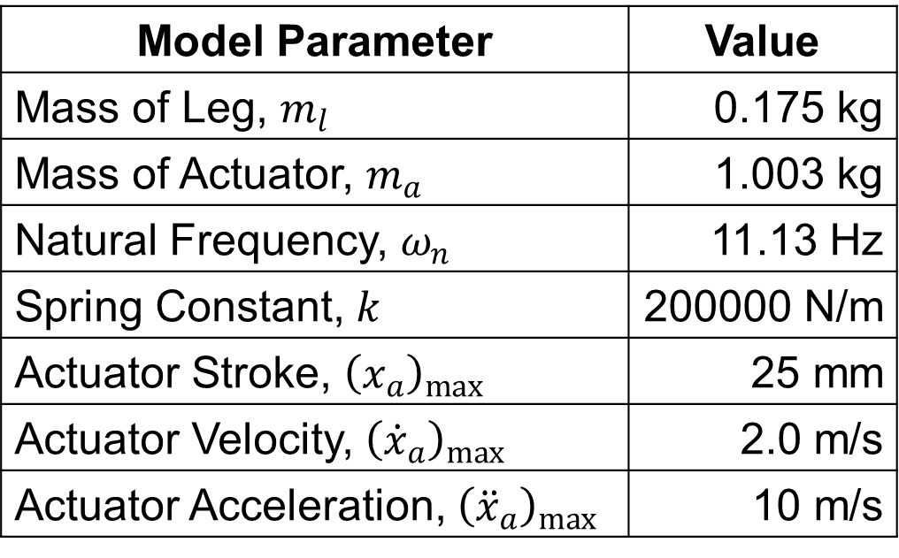
Flexible Jumping System
Model Parameter | Value
Mass of Leg, $m_{l}$ | 0.175 kg
Mass of Actuator, $m_{a}$ | 1.003 kg
Natural Frequency, $ω_{n}$ | 11.13 Hz
Spring Constant, $k$ | 200000 N/m
Actuator Stroke, ${\left(x_{a}\right)}_{max}$ | 25 mm
Actuator Velocity, ${\left({\dot{x}}_{a}\right)}_{max}$ | 2.0 m/s
Actuator Acceleration, ${\left({\ddot{x}}_{a}\right)}_{max}$ | 10 m/s
Notes:
The pogo-stick system shown here was used to represent a general flexible-legged jumping system.
The actuator mass m_a is controlled to move along the rod m_l propelling it vertically up or down. A massless spring, and damper, (which is not shown in the figure) are modeled such that the system can bounce off the ground. Additionally, the system is constrained so that it can only move vertically.
This model has been proven to be useful as the bases to describe many different flexible-legged system and therefore was used to describe a flexible-legged jumping system in this work.
The EOMs of this system can be seen in the lower part of the slide.
Alpha in this case is used to represent the systems contact with the ground such that the spring and damper do not influence the systems dynamics unless the system is in contact with the ground.
The values used in this work for the model parameters are highlighted in the table presented.

Slide 8
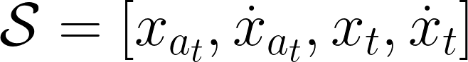
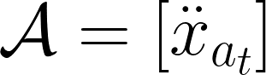
Environment Spaces
Notes:
The states sent to the training algorithm during training, and the agent during controlling, are the actuator’s position and velocity along the rod, as well as the rod’s position and velocity in space.
The action sent to the environment (i.e. the pogo-stick) is the acceleration of the actuator mass.

Slide 9
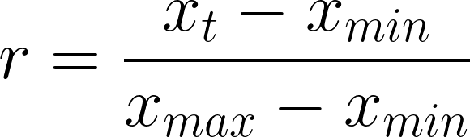
Reward Jumping High
Notes:
Since the reward is used to train an agent, two different rewards were used to train two kinds of agents to evaluate if RL can be used to define power efficient control strategies for flexible legged locomotive systems.
The first, highlighted here, is a function that rewards the agent based on height alone. That is, the control policy will be to maximize height. The reward returned to the learning algorithm is normalized to increase its ability to find a good strategy.

Slide 10
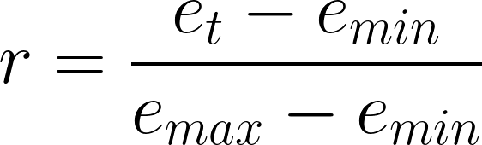
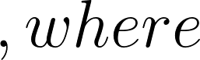
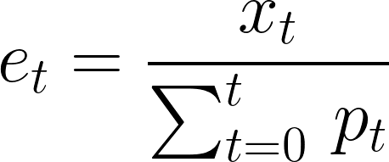
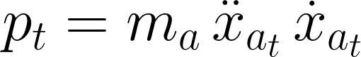
Reward Jumping Efficiently
Notes:
The second reward case, highlighted here, rewards efficiency, and again is normalized.
(click)
Efficient is defined in this work as the height at the current timestep divided by the sum of power used to get to that height.
(click)
Power in this case is defined mechanically as the product of the actuators mass, acceleration and velocity.

Slide 11
Training Schedule
Task | Jump Type | # Agents | Network Seeds
Jump Hight | Stutter Jump | 10 | 9, 16, 104, 107, 250, 676, 868, 878, 918, 947
 | One Jump | 10
Conserve Power | Stutter Jump | 10
 | One Jump | 10
Notes:
To further evaluate if RL is a viable method for finding efficient control strategies, two different jumping commands were tested.
A stutter jumping command, and a single jumping command. Details on these will follow in the coming slides.
In total, 10 different agents were trained to jump efficiently, and 10 were trained to jump high, both for two different jumping commands. This was done to determining the robustness of TD3.

Slide 12
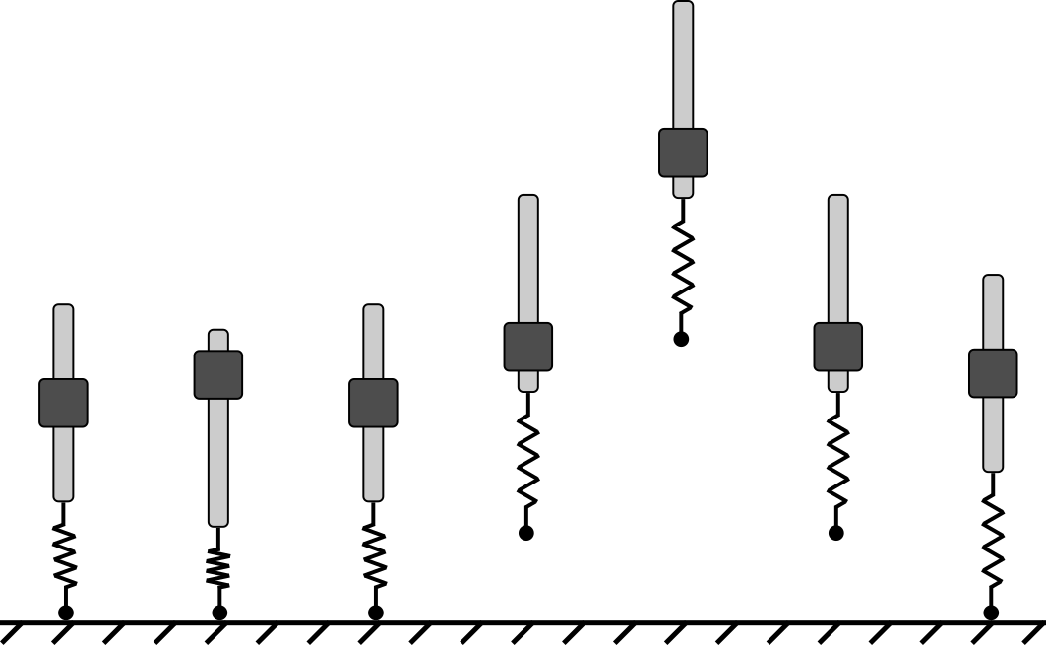
Single Jump
Notes:
An example single jump is presented here.
(click)
The pogo-stick starting from a resting position would ideally compress the spring
(click)
and then launch into the air completing a single jump.

Slide 13
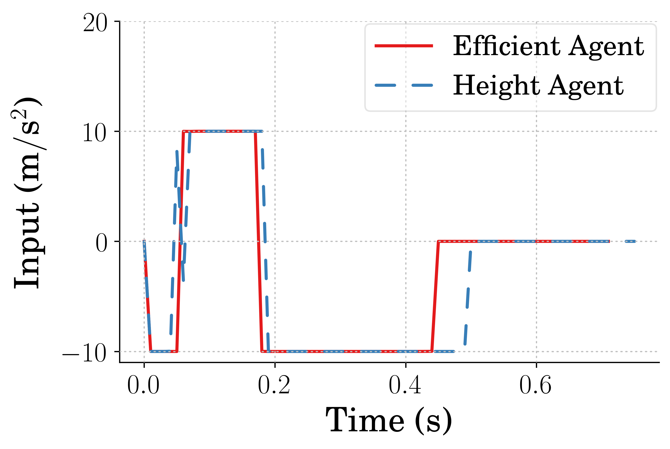
Single Jump Input
Notes:
Example input commands for the agents learning to jump high and the agents learning to jump efficiently for the single jumping case are shown here.
(click)
There is a significant timing difference between the two during the first upward acceleration command. This, as will be presented in a few slides, makes a difference in both height achieved, and power used.

Slide 14
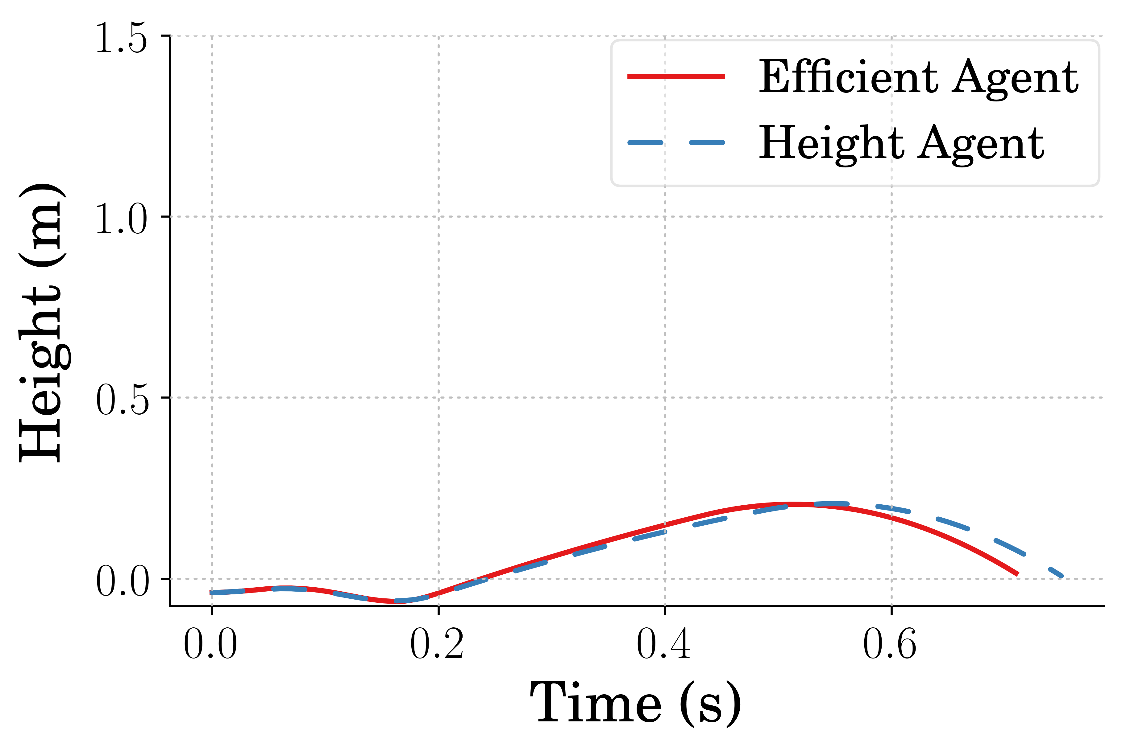
Single Jump Height Reached
Notes:
Presented here is an example jumping response of the efficient and high jumping agents, again for the single jumping input command.
(click)
It can be observed that there exists little difference in height achieved.
However, the difference in power used, which will be highlighted in the next slide, is substantial.

Slide 15
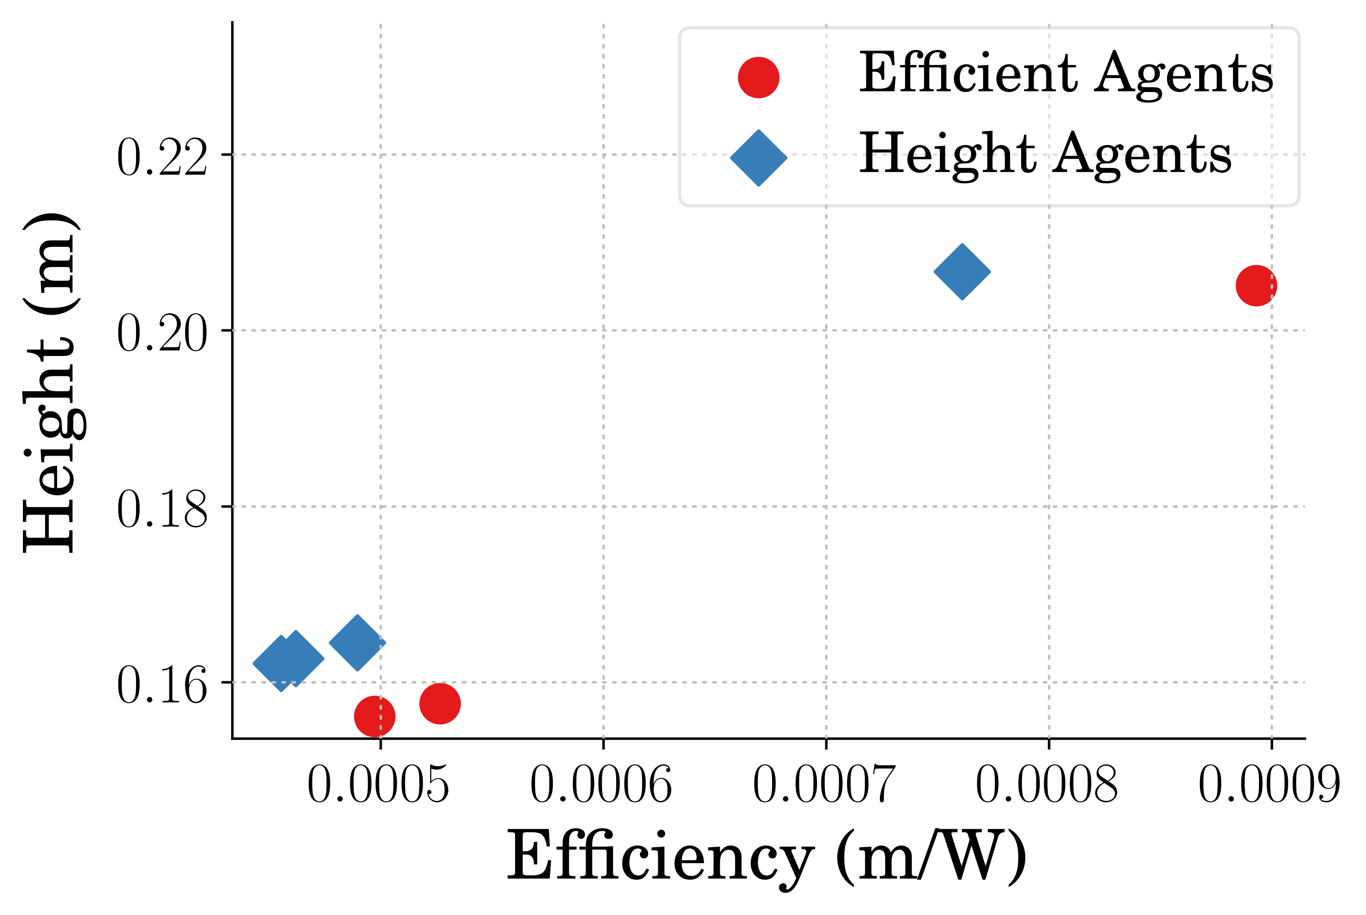
Single Jump Performance
Notes:
Shown here is the efficiency and height of all the agents trained for the single jumping command.
First, there are less than 10 in each case. The agents which are not presented did not learn to get off the ground at all. In both cases as well, the network initialization seemed to be the primary factor for this as there were common network initialization seeds for both agent types that failed to learn jumping control strategies.
(click)
Two outliers are present in this data, both which where trained from the same network initializations. Interestingly these outperform the rest of the agents in terms of both height and efficiency.
Regardless, it is apparent that in general the agents which were trained to jump high did learn higher jumping commands on average and the agents that learned to jump efficiently did so on average.
Note:
Best High agent jumped only 0.77% higher
0.61% higher average for high agent
0.76% higher max for high agent
17.91% more efficient average for the efficient agents
17.33% more efficient max for the efficient agent

Slide 16
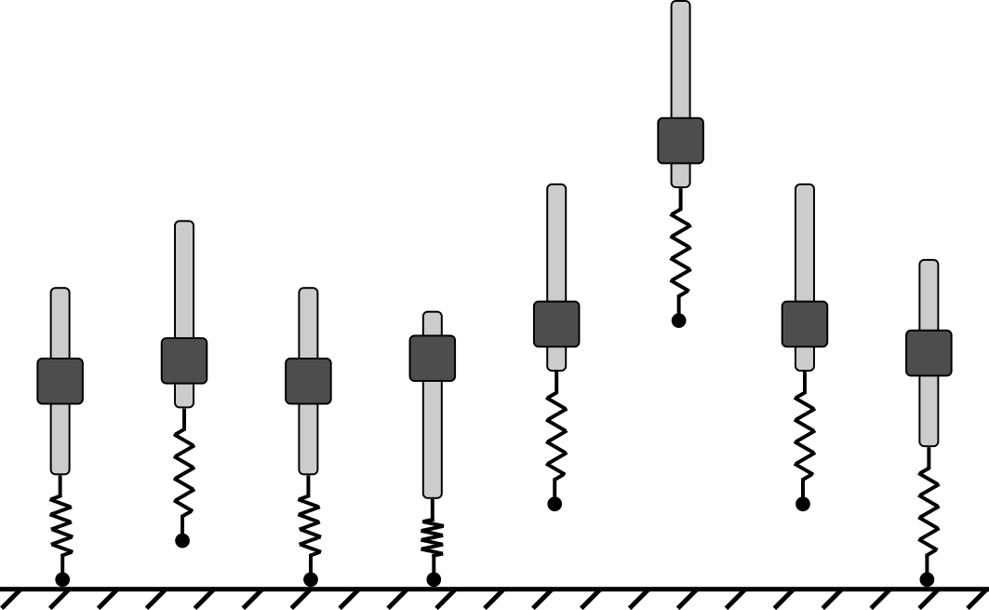
Stutter Jump
Notes:
An example jumping response for the stutter jumping command is presented here.
(click)
Notice the agent might learn to jump the pogo-stick off the ground as high as possible for the first jump,
(click)
therefore allowing it to compress the spring as far as possible to create as much spring energy to use for the final jump.

Slide 17
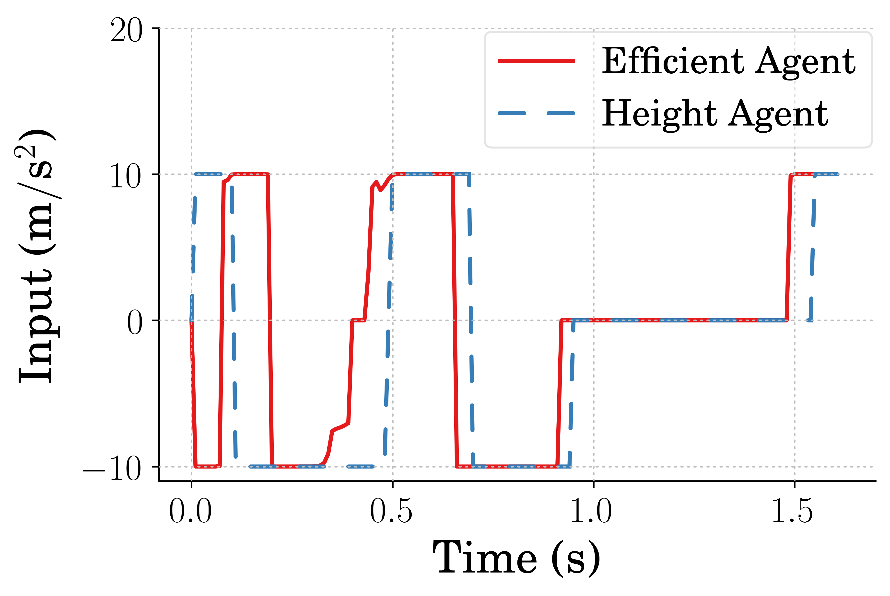
Stutter Jump Input
Notes:
Agents tasked with learning high and efficient control strategies for the stutter jumping command will generate control inputs like what are presented here.
Given a more dynamic jump, the agents learned significantly different commands when comparing both control inputs.
(click)
Most interesting is the efficient agents learned to initially accelerate the actuator in the negative direction which might allow the spring to decompress while maintaining contact with the ground.

Slide 18
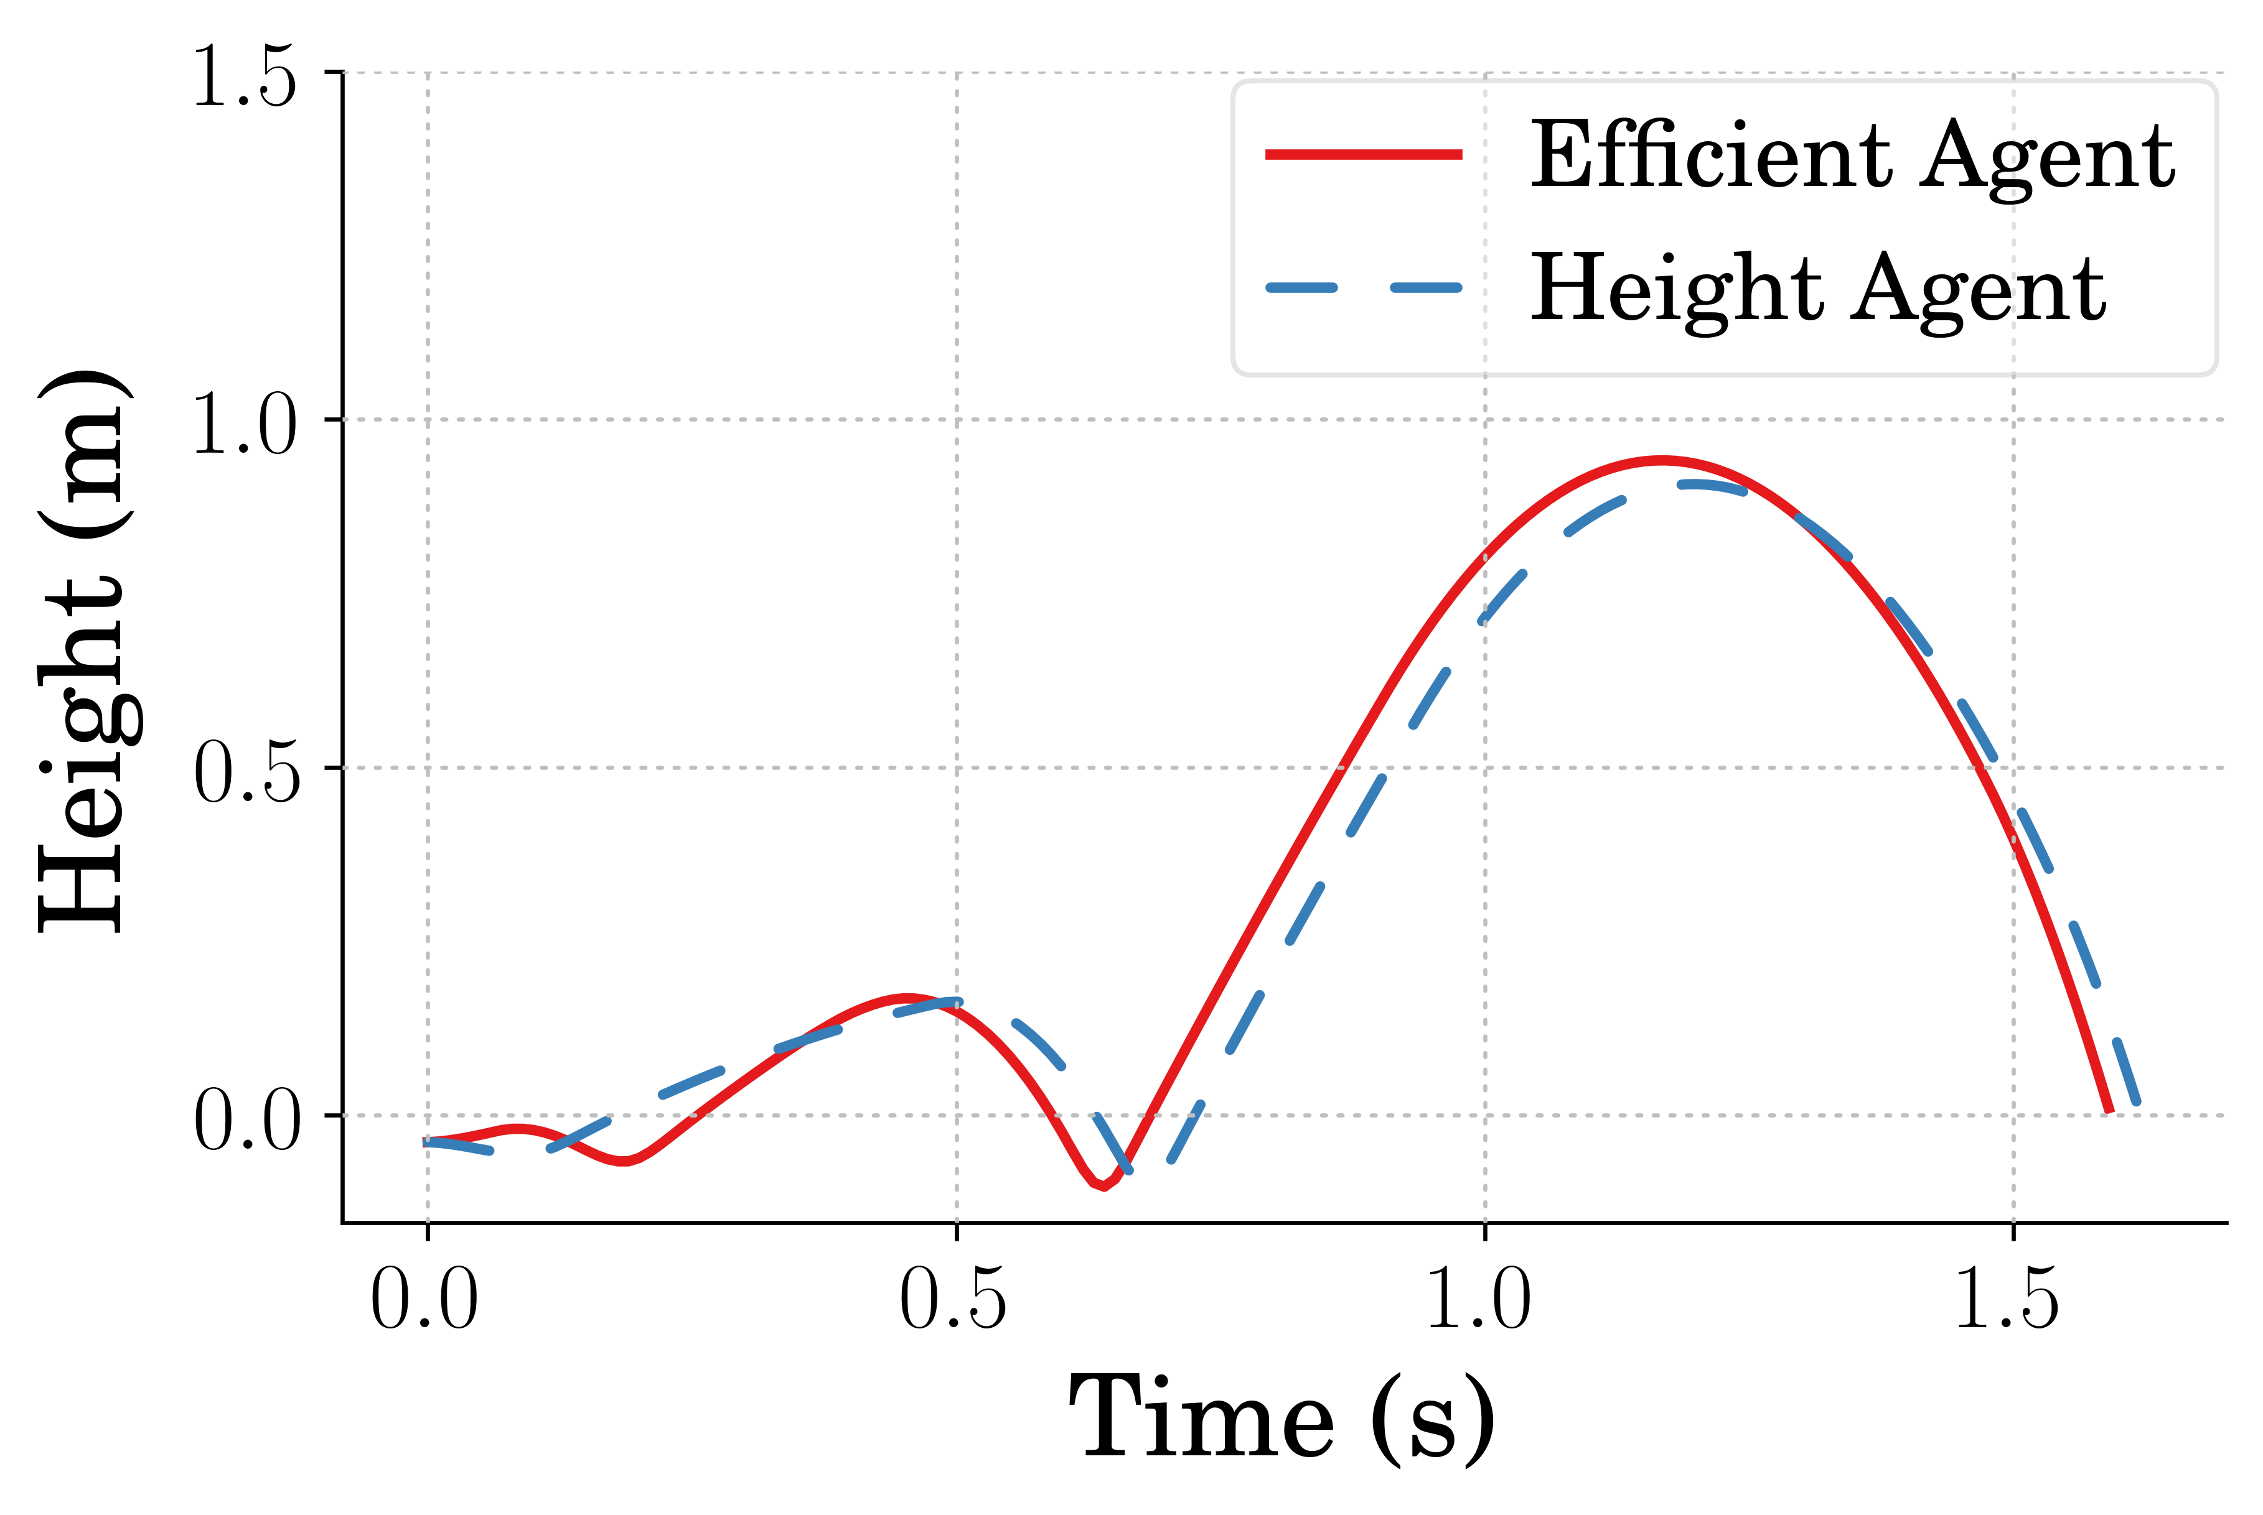
Stutter Jump Height
Notes:
The jumping responses can be seen here for the stutter jumping case,
(click)
and as expected the efficient agents learned a strategy that decompresses the spring right up to the point where the pogo would leave the ground before recompressing it.
(click)
Additionally, the efficient agents, having learned a unique way to accomplish the stutter jump, also learned a strategy to jump the pogo higher than the agents trying to jump as high as possible.
Note:
Best Efficient agent jumped only 3.87% higher while also being 23.62% more efficient
2.22% higher average for eff agent
2.75% higher max for eff agent
10.56% more efficient average for the efficient agents
13.84% more efficient max for the efficient agent

Slide 19
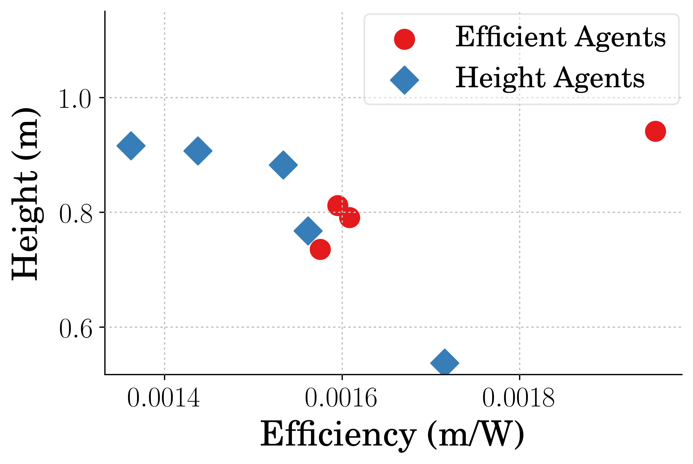
Stutter Jump Performance
Notes:
The height and efficiency of all the agents learning to jump high and efficiently for the stutter jumping case are presented here, and again there are less than 10 in each case. This seemed to be due to network initializations again as there were common network initializations that failed to learn jumping strategies for both cases.
Though it may be harder to determine here, the efficient agents learned both higher and more efficient jumping strategies for the stutter jumping command.
(click)
Additionally, after removing the outliers, the efficient agents learned more consistent strategies across different network initializations.
Note:
Best Efficient agent jumped only 3.87% higher while also being 23.62% more efficient
2.22% higher average for eff agent
2.75% higher max for eff agent
10.56% more efficient average for the efficient agents
13.84% more efficient max for the efficient agent

Slide 20
Conclusion
Reinforcement learning can be used to find control policies that are more efficient
Agents can learn efficient control strategies where more complex control inputs are required
Controllers can be learned that are both higher in performance and efficiency metrics
Notes:
In conclusion
(click)
Reinforcement learning can be used to find control policies that are more efficient for flexible legged jumping systems.
(click)
Furthermore, Agents can learn efficient control strategies where more complex control inputs are required
(click)
And in some cases, Controllers can be learned that are both higher in performance and efficiency metrics

Slide 21
Thank you.
Notes:
Thank you so much for your time. I would be happy to take some questions!

Slide 22
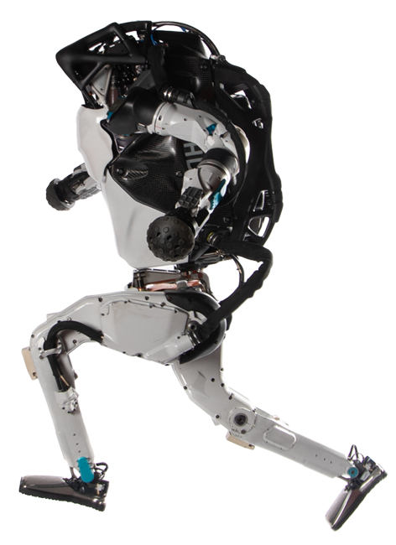
Legged & Flexible Robots
Pros
Ability to navigate uneven terrain
Different designs can be useful for different tasks
Can be designed to adapt to different terrain
Cons
Difficult to design stable controllers
Systems require high amounts of power
Difficult to design to overcome different obstacles
https://www.bostondynamics.com/atlas
Notes:
TODO:
Get citation

Slide 23
Legged & Flexible Robots
Pros
Increases in efficiency
Better stability through adaptability
Higher performance
Running speed
Jumping height
Cons
Difficult to define models for due to non-linearities
Challenging to create controllers for
Notes:
TODO:
Get citation

